Slide 1
Tables
Tables provide a means of organising the layout of data
A table is divided into rows and columns: these specify the cells of the table
Cells can contain text, images, links, other tables...
Tables can also be used for organising the layout of the web page itself.

Slide 2
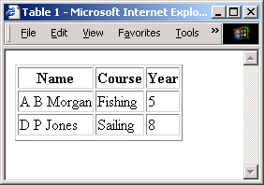
Tables
<table border="1">
<tr>
<th>Name</th>
<th>Course</th>
<th>Year</th>
</tr>
<tr>
<td>A B Morgan</td>
<td>Fishing</td>
<td>5</td>
</tr>
<tr>
<td>D P Jones</td>
<td>Sailing</td>
<td>8</td>
</tr>
<tr>
</table>
<table> main element
<tr> table row
<th> table header
<td> table data

Slide 3
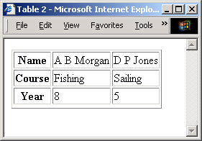
Tables
<table border="1">
<tr>
<th>Name</th>
<td>A B Morgan</td>
<td>D P Jones</td>
</tr>
<tr>
<th>Course</th>
<td>Fishing</td>
<td>Sailing</td>
</tr>
<tr>
<th>Year</th>
<td>8</td>
<td>5</td>
</tr>
<tr>
</table>
<table> main element
<tr> table row
<th> table header
<td> table data

Slide 4
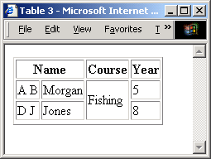
Rows and Columns
<table border="1">
<tr>
<th colspan="2">Name</th>
<th>Course</th>
<th>Year</th>
</tr>
<tr>
<td>A B</td>
<td>Morgan</td>
<td rowspan="2">Fishing</td>
<td>5</td>
</tr>
<tr>
<td>D J</td>
<td>Jones</td>
<td>Sailing</td>
<td>8</td>
</tr>
<tr>
</table>
Cells can span multiple columns and multiple rows with the colspan and rowspan attributes

Slide 5
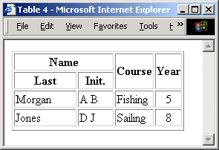
The align and width attributes
The align attribute determines the position of the text within a cell
The width attribute determines the width of the row relative to the table
<table border="1" align="center">
<tr>
<th colspan="2" width="60%">Name</th>
<th rowspan="2">Course</th>
<th rowspan="2">Year</th>
</tr>
<tr>
<th>Last</th>
<th>Init.</th>
</tr>
<tr>
<td>Morgan</td>
<td>AB</td>
<td>Fishing</td>
<td align="center">5</td>
</tr>
<!– etc -->

Slide 6
Table attributes
Table attributes
  align alignment relative to the page
  width in pixels or percentage of page width
  border - width of border (pixels)
  cellspacing separation between cells (pixels)
  cellpadding - space around data inside cell (pixels)
  bgcolor - background colour (inside cells)
Furthermore
The <caption> element puts a title above the table

Slide 7
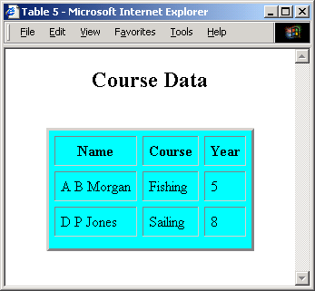
Table attributes
<table border="3" align="center" cellspacing="6" cellpadding="6" bgcolor="cyan">
<caption>
<h2>Course Data</h2>
</caption>
<tr>
<th>Name</th>
<th>Course</th>
<th>Year</th>
</tr>
<tr>
<td>A B Morgan</td>
<td>Fishing</td>
<td>5</td>
</tr>
<!– etc -->

Slide 8
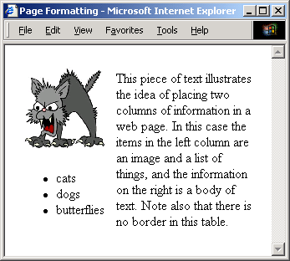
Page formatting
</body>
<table border="0" cellspacing="10">
<tr>
<td>
<img src="cat.gif" alt="cat">
<ul>
<li>cats</li>
<li>dogs</li>
<li>butterflies</li>
</ul>
</td>
<td>
This piece of text illustrates
the idea of placing two columns
of information in a web page...
Note also that there is no
border in this table.
</td>
</tr>
</table>
</body>
Tables can be used to organise the layout of the web page itself

Slide 9
Frames and Framesets
A frameset partitions a web browser window so that multiple web documents can be displayed simultaneously.
Example application: To maintain a permanently visible directory of links within your site, while also displaying one or more selected documents from the site.
  otherwise the directory of links must appear on every page, and this scrolls up with the page
Note: framesets can cause problems for bookmarking and for "screen readers" (for visually-impaired users)

Slide 10
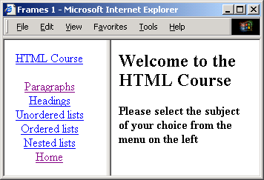
Framesets
<html>
<head><title>Frames 1</title></head>
<frameset cols="140,*">
<frame name="navF" src="navigation.html">
<frame name="mainF" src="intro.html">
</frameset>
</html>
The frameset element replaces the body element
frameset has attributes cols or rows, defined in terms of pixels, percentage(%) or unspecified (*)
  this splits the window into two or more columns or rows

Slide 11
Frame attributes
<frameset cols="140,*">
<frame name="navF" src="navigation.html">
<frame name="mainF" src="intro.html">
</frameset>
The name attribute uniquely identifies the frame. It may be used as the target in an anchor (<a>) element
The src attribute specifies the web page to be placed in the frame initially (it may subsequently be overwritten)
The scrolling attribute ("auto", "yes", "no") specifies whether the frame is to have scroll bars
The frameborder attribute ("0", "1") specifies whether the frame is to have a border

Slide 12
navigation.html
The anchor tag has a target attribute
  takes the name of the frame used to display the information
All anchors below are targeted to the "mainF" frame
<html><head><title>Navigation Bar</title></head>
<body><center>
<a href="course.html" target="mainF">HTML Course</a><br><br>
<a href="paragraph.html" target="mainF">Paragraphs</a><br>
<a href="headings.html" target="mainF">Headings</a><br>
<a href="ulists.html" target="mainF">Unordered lists</a><br>
<a href="olists.html" target="mainF">Ordered lists</a><br>
<a href="nlists.html" target="mainF">Nested lists</a><br>
<a href="intro.html" target="mainF">Home</a><br>
</center></body>
</html>

Slide 13
intro.html
A simple document which is initially placed in the "mainF" frame
This is replaced when a user clicks on a link in the "navF" frame
<html>
<head><title>Internet Computing</title></head>
<body>
<h2>Welcome to the HTML Course</h2>
<p>
<h4>Please select the subject of...</h4>
</p>
</body>
</html>

Slide 14
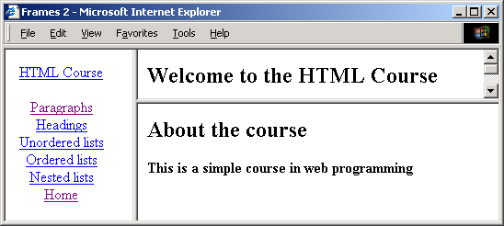
Nested framesets
<html>
<head><title>Frames 2</title></head>
<frameset cols="140,*">
<frame name="navF" src="navigation.html">
<frameset rows="30%,70%">
<frame name="upperF" src="intro.html">
<frame name="lowerF" src="course.html">
</frameset>
</frameset>
</html>

Slide 15
Noframes
Some browsers cannot process frames. Alternative content should be provided using the noframes element
<html>
<head><title>Frames 1</title></head>
<frameset cols="140,*">
<frame name="navF" src="navigation.html">
<frame name="mainF" src="intro.html">
</frameset>
<noframes>
<body>
Something here for browsers not supporting frames
</body>
</noframes>
</html>

Slide 16
Forms
Forms are user interfaces for data input
Main application: to provide user input for
  programs and databases located on a web server
  local (client-side) scripts associated with the form
Server-based programs may return data to the client as a web page
Client-side scripts can read input data
  To validate the data, prior to sending to server
  To use in local processing which may output web page content that is displayed on the client

Slide 17
Example applications
Questionnaires to provide feedback on a web site
e-commerce, to enter name, address, details of purchase and credit-card number
  request brochures from a company
  make a booking for holiday, cinema etc.
  buy a book, cd, etc
  obtain a map giving directions to a shop
Run a database query and receive results (an important part of e-commerce)

Slide 18
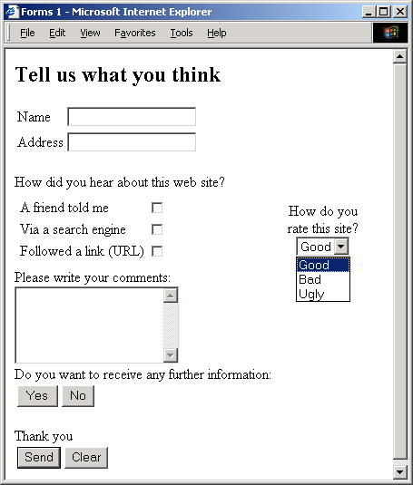
Input types
text
checkbox
radio (buttons)
select (options)
textarea
password
button
submit
reset
hidden
file
image

Slide 19
The method and action attributes
The method attribute specifies the way that form data is sent to the server program
  GET appends the data to the URL
  POST sends the data separately
The action attribute specifies a server program (e.g. a perl program .pl extension) that processes the form data
Can also send an email: action=“mailto:D.P.Cosker@..”
<body>
<form method="POST" action="comments.pl">
<h2>Tell us what you think</h2>
<!-- etc -->
</form>
</body>

Slide 20
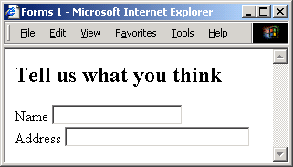
The input element: type="text"
The type attribute specifies the type of user input
The name attribute gives an identifier to the input data
The size attribute specifies the length of the input field
The value attribute specifies an initial value for the text (optional)
<form method="POST" action="comments.pl">
<h2>Tell us what you think</h2>
Name <input name="name" type="text" size="20"><br>
Address <input name="address" type="text" size="30">
</form>

Slide 21
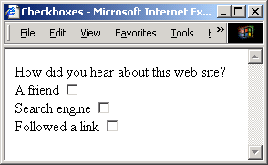
The input element:type="checkbox"
The name attribute is used to define a set of checkboxes
The value attribute identifies the individual checkbox
If the checked attribute is set the box is initially checked
How did you hear about this web site?<br>
A friend
<input type="checkbox" name="howdid" value="friend"><br>
Search engine
<input type="checkbox" name="howdid" value="engine"><br>
<!– etc -->

Slide 22
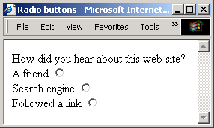
The input element: type="radio"
Radio buttons are similar to checkboxes, but only one can be selected
To select a button by default, use the checked attribute (for one button only)
How did you hear about this web site?<br>
A friend
<input type="radio" name="howdid" value="friend"><br>
Search engine
<input type="radio" name="howdid" value="engine"><br>
<!– etc -->

Slide 23
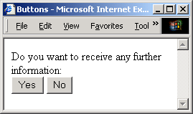
The input element: type="button"
The name attribute uniquely identifies a button
The value attribute gives a label to the button
Actions can be associated with buttons- more later
Do you want to receive any further information:<br>
<input type="button" name="yes" value=" Yes ">
<input type="button" name="no" value=" No "><br>

Slide 24
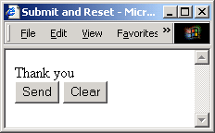
The input element: type="submit/reset"
type="submit"
  clicking this button sends the form data to the program (URL) specified in the action attribute of the form
type="reset"
  clicking this button clears all data entered so far
Thank you<br>
<input type="submit" name="send" value="Send">
<input type="reset" name="clear" value="Clear"><br>

Slide 25
The input element: type="password/file/hidden"
type="password"
  similar to type="text" except that the input is echoed with asterisks (so not visible)
type="file"
  provides a file dialogue box to specify a file that is sent to the server
type="hidden"
  similar to text input, but the value attribute is used to specify data that is to be sent to the server. Nothing appears on the screen.
  The data might be set by a server program to keep track of the details of a particular transaction.

Slide 26
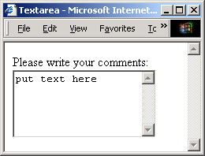
The textarea element
Used for multi-line text input
The size of the input area is specified with the cols and rows attributes
Any text placed inside the element appears in the input area (this can be deleted).
Please write your comments:<br>
<textarea name="comments" rows="5" cols="20">
put text here
</textarea>

Slide 27
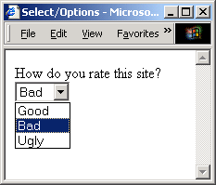
The select element
The select element provides a menu of options
An option can be selected by default using the selected attribute (otherwise the first in the list is initially selected)
How do you rate this site?<br>
<select name="rating">
<option>Good
<option selected>Bad
<option>Ugly
</select>

